Slide 1
Biodiversity in national parks:
A capstone for intro to data analysis
Presented by: Patrick d. harms

Slide 2
Species_info.csv
There are 5541 unique species contained in this file.
These fall into 7 different types, ranging from Mammal to Nonvascular Plant
Species are also grouped into conservation status groups. Thankfully, most of these values are null.

Slide 3
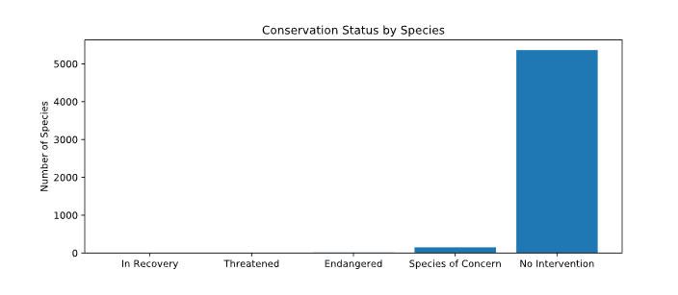
Species_info.csv Graph

Slide 4
Endangered species analysis
Using Pandas, data was manipulated into a pivot table and percentages of each type that is endangered.
By performing a Chi Squared test, we determined that there was no significant difference in the number of protected birds and mammals.
In a separate Chi Squared test, it was determined that there was a significant difference the number of protected reptiles and mammals.

Slide 5
Endangered species analysis
There actually was a large difference between the number of protected mammals and reptiles.
Conservationists should spend a significantly larger amount of time working with mammals than reptiles.
Tests like this can show how resources should be allocated to better support biodiversity in national parks and help a greater number of species.

Slide 6
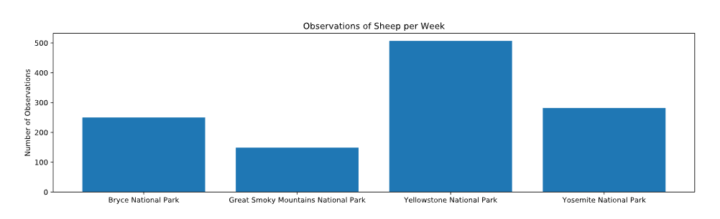
Graph of sheep observations

Slide 7
Sheep Foot and Mouth
Sheep in the parks were found to have Foot and Mouth disease that needed to be treated and the number of sick sheep decreased.
Through some data wrangling, the number of weekly sheep sightings was determined in each park.
Scientists had little data to go on, needed to determine the number of observations needed to show improvement.

Slide 8
Sample Size determination
15% of sheep in the park likely had foot and mouth disease, based on data from the year previous. This number became the baseline to determine the sample size.
Scientists wanted to be able to observe drops of at least 5% of the total population or 33% of the baseline with at least 90% confidence.
This size of drop, given the population size and that level of confidence make for a small sample size of 870.

Slide 9
Sample size determination
Given the calculated results, just less than 2 full weeks of observations will have to happen if scientists are to be sure that there has been a decline in the number of cases of foot and mouth disease among sheep.

